Slide 1

JHSCC
Infection Control Education

Slide 2
INSTRUCTIONS
Welcome, you are about to participate in an infection control educational
module.
This module contains information and questions.
At the end of the presentation, there will be a quiz, and you must get a perfect score to receive credit. You will be able to see your results and retake the quiz if needed.
You will be asked for your identifying information at the end of the
session so that you can receive credit for taking this module.
If you have questions about any of the information contained in this
educational module please call Infection Control Department at
(312) 864-4581.

Slide 3

Review of General Infection Control Practices

Slide 4
Standard (Universal) Precautions
Based on the premise that transmission of disease occurs when healthcare workers are exposed to persons with undiagnosed infectious diseases
Routinely use personal protective equipment (PPE), engineering controls, and safe work practices to prevent direct contact with blood, body fluids/substances, mucous membranes, non-intact skin, and surfaces contaminated with blood and body fluids/ substances

Slide 5
Examples of PPE and Engineering Controls
PPE
Gowns
Gloves
Eye/Face Protection
Masks
Engineering Controls
Sharps Containers
Centrifuge covers/splash shields
Needleless or blunt cannula systems
Sharps with engineered sharp injury protection

Slide 6
Safe Work Practices
Activities you can control to make the environment safe for everyone
Eating, drinking, applying cosmetics or manipulating contact lenses should be performed ONLY in areas where there is NO risk for contact with blood/body fluids
(Occupational Safety and Health Administration)

Slide 7
Recovery of VRE from Hands and Environmental Surfaces
Up to 41% of HCWs hands sampled (after patient care and before hand hygiene) were positive for VRE¹
VRE has been recovered from a number of environmental surfaces in patient rooms
VRE can survive on a countertop for up to 7 days²
¹ Hayden, Clinical Infectious Diseases 2000;31:1058-65
² Noskin, Infection Control and Hospital Epidemiology 1995;16:577-581

Slide 8
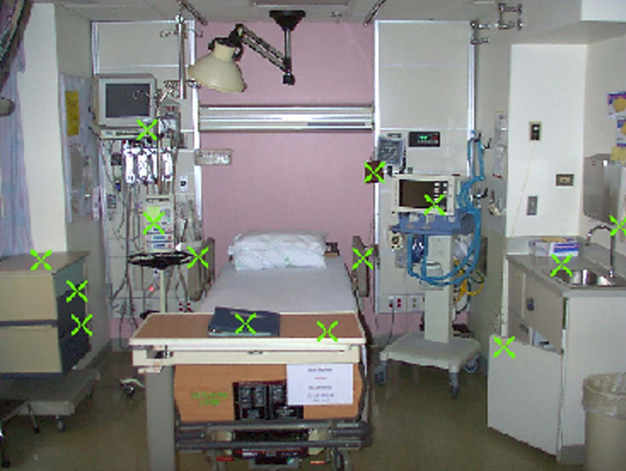
The Inanimate Environment Can Facilitate Transmission
X represents VRE culture positive sites
~ Contaminated surfaces increase cross-transmission ~
MK Hayden, The Risk of Hand and Glove Contamination after Contact with a VRE (+) Patient Environment. ICAAC 2001.

Slide 9
SURFACE DISINFECTION
A quaternary ammonium (QUAT) + isopropyl alcohol product is used for surface disinfection throughout the hospital.
It is a ready to use (RTU) formulation available for use by all staff.
The contact time (stated on the product label) is required in order to be effective.
Wet the surface to be disinfected and allow to air dry. DO NOT WIPE DRY.

Slide 10
Transfer of Patient in Isolation
From sending department
  Hand-off communication : Verbally communicate with the receiving department about patient’s isolation status; ascertain Personal Protective Equipment (PPE) is available
  Perform hand hygiene, don required PPE , place clean sheet on gurney/wheelchair, transfer patient to gurney/wheelchair
  Remove PPE and perform hand hygiene before leaving the room
During transport
  Staff should not wear any PPE in hallway or elevator (CDC Guideline for Isolation, 2007), except when:
    patient is intubated
    there is non-contained blood or body fluids
    instructed by Infection Control
At receiving department
  Don required PPE.
  Transfer the patient to bed or examination table.
  Remove PPE and perform hand hygiene before exiting the room.
  Wipe gurney or wheelchair with hospital approved surface disinfectant and allow to air dry.

Slide 11
Potentially Infectious Medical Waste
Include:
All blood/body fluids, or disposable items contaminated with blood or body fluids that are not contained and may leak or drip
All laboratory waste that has not been rendered non-infectious
Contaminated sharps

Slide 12
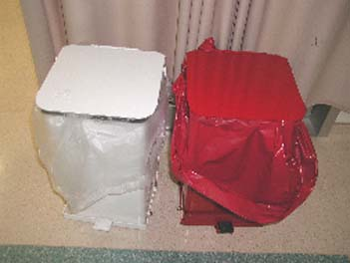
Think Before You Dispose of Waste
White
Tissue Paper
Newspaper
Sterile Tray Wrapper
IV Tubing without visible blood
Disposable patient care items if not saturated or caked with blood/body fluids
3.5¢/pound of regular waste
Red
Blood soaked gauze
Blood bag and tubing
Lab specimens and culture plates
Bloody OR drapes
19¢/pound of red bag waste

Slide 13
Red Bag Waste
According to Environmental Services, JSH generates an average of 2 million pounds of red bag waste each year. The actual cost per year is approximately $380,000.
The excess 600,000 pounds of red bag waste costs JSH an extra $114,000 per year!

Slide 14
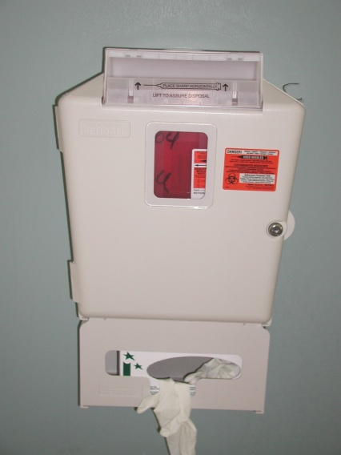
Point of Use Disposal
The sharps disposal container must be used for:
  Needles
  Blades
  Scalpels
  Any sharp object that might penetrate the trash bag
* Never place anything on top of the sharps disposal cabinet.
It may obstruct safe disposal and result in an exposure.
* Replace the sharps disposal liner when ¾ full and NEVER
force a sharp into the liner.

Slide 15
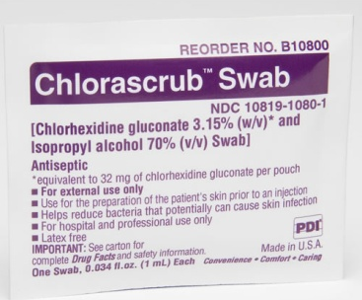
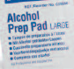
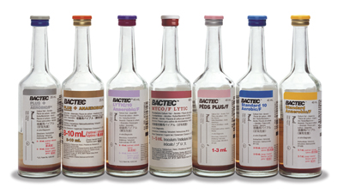
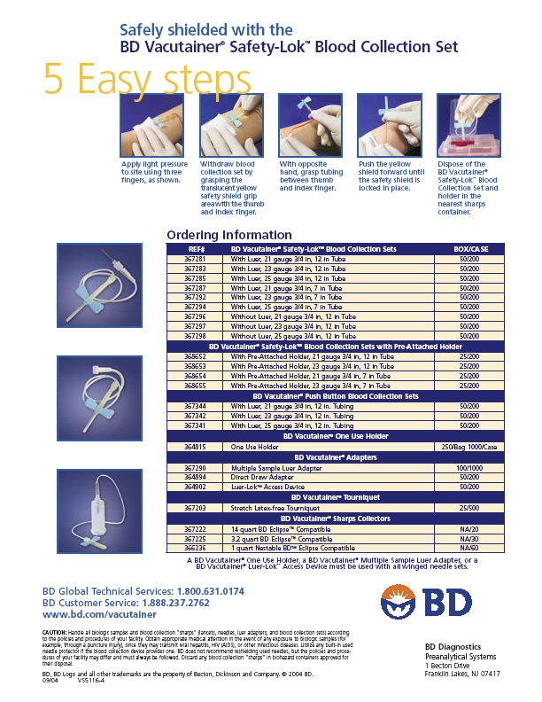
Blood Culture Collection
With circular motion , disinfect skin with Chlorhexidine.
Disinfect ports with alcohol.
Disinfect diaphragm of blood culture bottles with alcohol .
Use sterile Vacutainer Safety-Lok® blood collection set.
Do not use blood culture bottles that are missing its “pop-off” cap.
TWO SETS (2 bottles/set) OF BLOOD CULTURES ARE MANDATORY approximately 5-15 minutes apart from 2 separate sites.
Keep blood culture bottles in upright position; label the blood culture bottle to make sure 8-10 ml of blood sample is collected.

Slide 16
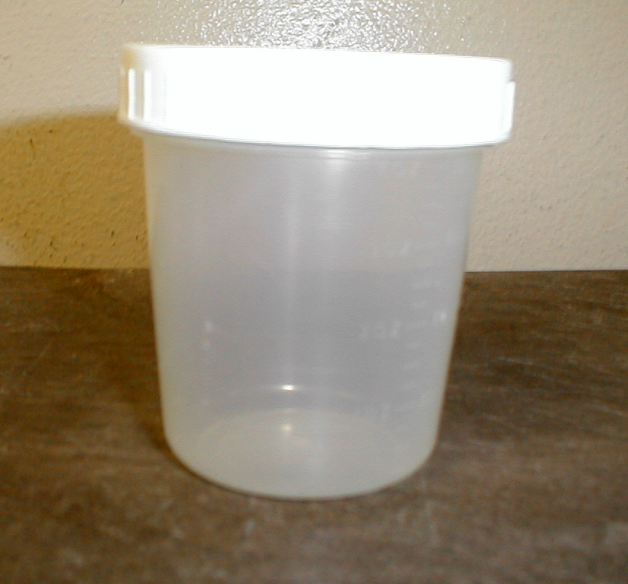
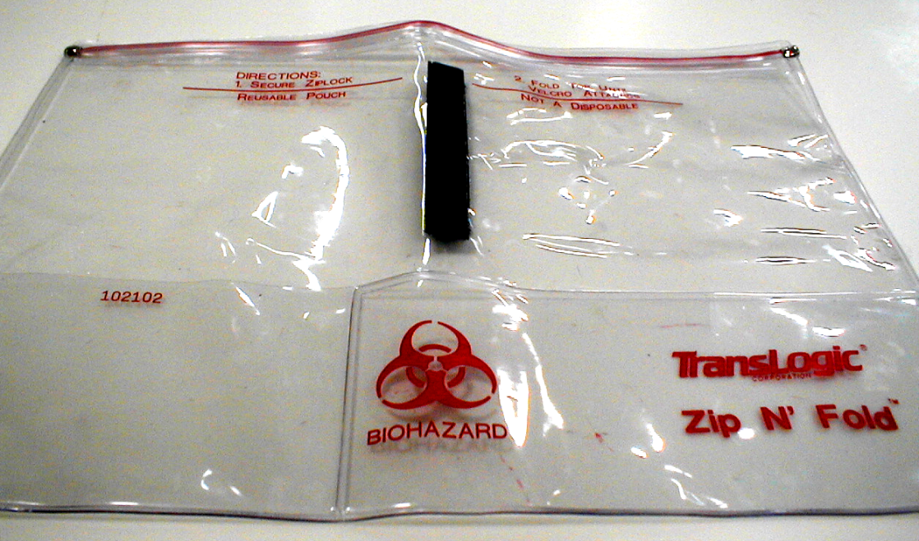
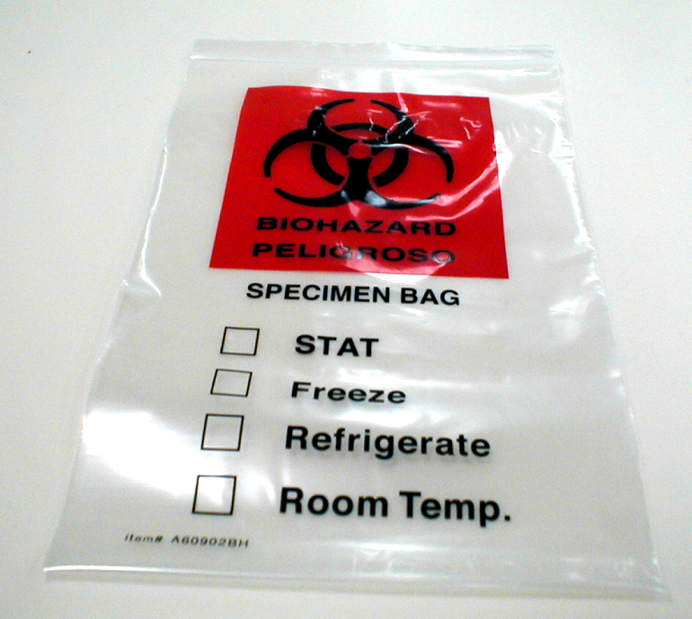
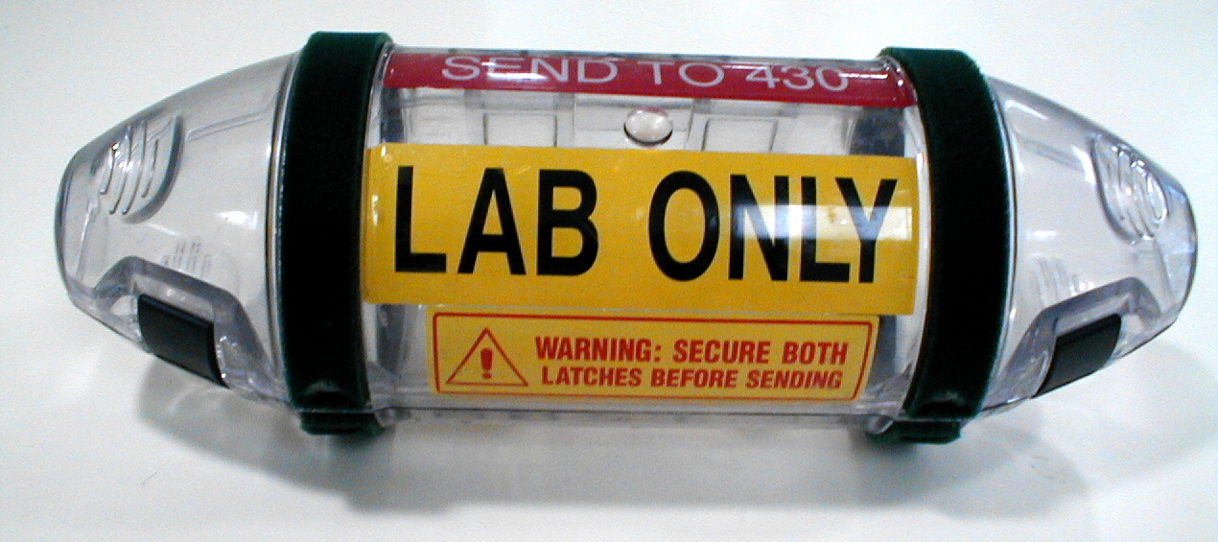
1
3
Specimen Container
Translogic Zip N’ Fold Bag
Never place a specimen DIRECTLY in the carrier!
2
4
Plastic Carrier
Specimen Bag

Slide 17
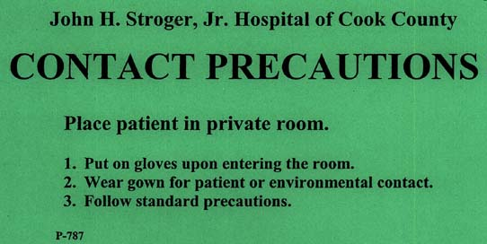
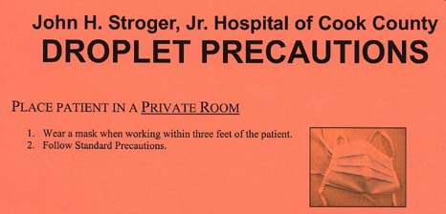
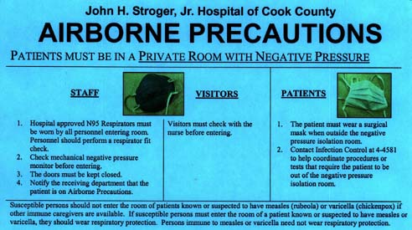
Example:
MRSA, VRE
Example:
TB
John H. Stroger, Jr. Hospital of Cook County
NEUTROPENIC PRECAUTIONS
ROOM: patients must be segregated in private room if available or single bed cubicle.
GLOVES: must be worn by all personnel having any patient contact.
HANDS: must be washed before and after delivery of patient care; and after removing gloves.
MASKS: must be worn by any personnel with colds, coughs and other respiratory infections coming in contact with patient.
Fresh fruits, vegetables and plants should not be left in patients’ room.
P-800
Example:
Meningitis,
Whooping
cough
Example:
Severely
immuno-
compromised
patients

Slide 18
MRSA/MDRO Legislation
MRSA-stands for Methicillin (Oxacillin)-Resistant Staphylococcus aureus.
  Staphylococcus aureus is a bacteria found on the skin or in noses Of healthy people.
  MRSA is a type of Staphylococcus aureus infection that is resistant to antibiotics making it more difficult to treat.
Public Act 095-0312-MRSA Screening and Reporting Act
  requires active surveillance testing for MRSA of all patients in
  intensive care units and other at-risk patients.
  requires isolation of MRSA-colonized or infected patients.
  requires monitoring and strict enforcement of hand hygiene.
  requires reporting of the total number of MRSA infections.
Public 095-0282- Section 10.5 -Prevention and Control of Multidrug- Resistant Organisms (MDRO)
  requires facilities to implement comprehensive interventions
  to prevent and control and report MDRO.
  requires enforcement of hand hygiene requirements.

Slide 20
MultiDrugResistantOrganisms
Transmission: once introduced into the hospital, transmission & persistence is determined by:
  vulnerable patients
  antimicrobial use
  the number of colonized & infected patients
  implementation & adherence to prevention efforts

Slide 21

MultiDrugResistantOrganisms
Microorganisms seen at Stroger Hospital
Gram negatives:
Acinetobacter baumannii— direct, indirect & environmental contact
E. Coli —GI tract, fecal contamination of equipment
VRE—found everywhere, opportunistic infections
Pseudomonas—contaminated water & fluids and equipment
KPC/ESBLs—long staying pts., ICUs, central lines, antibiotics
Gram positives:
MRSA—found everywhere, unwashed hands, contaminated equipment

Slide 22

MultiDrugResistantOrganisms
▬Transmission Prevention▬
The Joint Commission-2010 National Patient Safety Goal, 07.03.01- requires hospitals to implement evidence-based practices to prevent healthcare-associated infections due to MDRO.
Hand Hygiene is mandatory before entering and after exiting a patient’s room.
Follow contact precautions
A single room is preferred.
A gown & gloves are don prior to entering the room.
Discard PPE before exiting the room. Never reuse a yellow cover gown.
Educate patients and families about hospital acquired infections, MDRO, and prevention strategies

Slide 23
MultiDrugResistantOrganisms
▬Transmission Prevention▬
Environmental Measures:
Use dedicated non-critical equipment
Thoroughly clean and disinfect frequently touched surfaces (e.g. bedrails, charts, bedside commodes, doorknobs, etc.)
Environmental contamination is commonly found when there is a lack of adherence to facility cleaning & disinfection procedures
Use a hospital approved disinfectant to clean patient care equipment
Cleaning agents containing bleach maybe used to disinfect the environment of patients with Clostridium difficile only at the direction of Infection Control Department.

Slide 24
Surgical Site Infection Prevention
The Joint Commission- 2010 National Patient Safety Goal, 07.05.01- requires hospitals to implement evidence-based practices for preventing surgical site infections.
If necessary to remove hair, use clippers—NO RAZORS
Control blood glucose level for all postop patients particularly open heart patients
Use Chlorhexidine bath prior to surgery when appropriate

Slide 25
Surgical Site Infection Prevention
Administer antimicrobial prophylaxis in accordance with your department guidelines (see Cerner Intranet)

Slide 26
Healthcare Workers and Influenza Vaccine
The Advisory Committee on Immunizations recommends annual Influenza immunization for healthcare workers.
A 2002 CDC survey determined that only 38% of healthcare workers were vaccinated
During the 2009-2010 flu season, 2304 employees received seasonal influenza vaccine and 4413 employees received H1N1 vaccine (as 1/9/10) from JSHCC Employee Health Service.
Influenza vaccination of healthcare workers has been associated with reduced work absenteeism and fewer deaths among nursing home patients
Influenza outbreaks in hospitals have resulted from low vaccination rates among healthcare providers.

Slide 27
Protect Yourself – Protect Others
Get Your Flu Shot!
Influenza Vaccine
  Influenza vaccination can prevent you from giving the flu to your patients, your colleagues and your family.
  It prevents illness in 70-90% of healthy adults under 65 when the vaccine and the circulating strain match.
Vaccinate Your Patients
  The flu vaccine is the best way to prevent influenza hospitalizations and death.
  Influenza causes an average of 36,000 deaths and 200,000 hospitalizations per year in the U. S. (CDC data, September 2005
Protect Your Community
  Promote the flu vaccine throughout the influenza season.
  October and November are the best months to vaccinate, but the vaccine can be given as early as September and can be given in December and throughout the flu season.

Slide 28
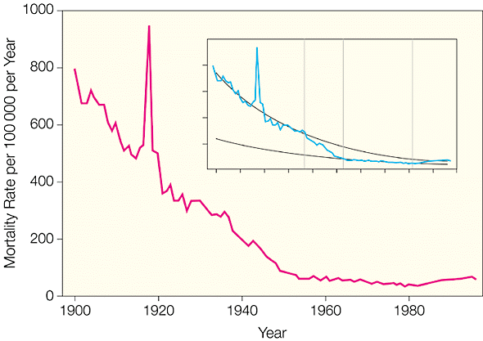
US Infectious Disease Mortality:
The Impact of Spanish Flu Outbreak of 1918
Spanish flu outbreak of 1918
AIDS
The Spanish Flu pandemic of 1918 had a much more deadly impact than the AIDS epidemic of the 1980s
Armstrong. JAMA 1999;281:61
Notes:
28

Slide 29
Flu Terms Defined
Seasonal (or common) flu is a respiratory illness that can be transmitted person to person. Most people have some immunity and a vaccine is available.
Novel Influenza A H1N1( previously swine) is a respiratory disease of pigs caused by Novel Influenza Type A H1N1. Human cases have been identified throughout the world (pandemic) including the United States. The virus is spread from person-to-person by exposure to infected droplets expelled by coughing or sneezing that can be inhaled, or that can contaminated hands or surfaces.
Avian (or bird) flu is caused by influenza viruses that occur naturally among wild birds. The H5N1 variant is deadly to domestic fowl and can be transmitted from birds to humans. There is no human immunity and no vaccine is available.

Slide 30
Last positive case
3/22/10
First positive case
4/27/09
Total Cases=295 ( Inpatient=145, Outpatient=131, EHS=11, No records=8)

Slide 31
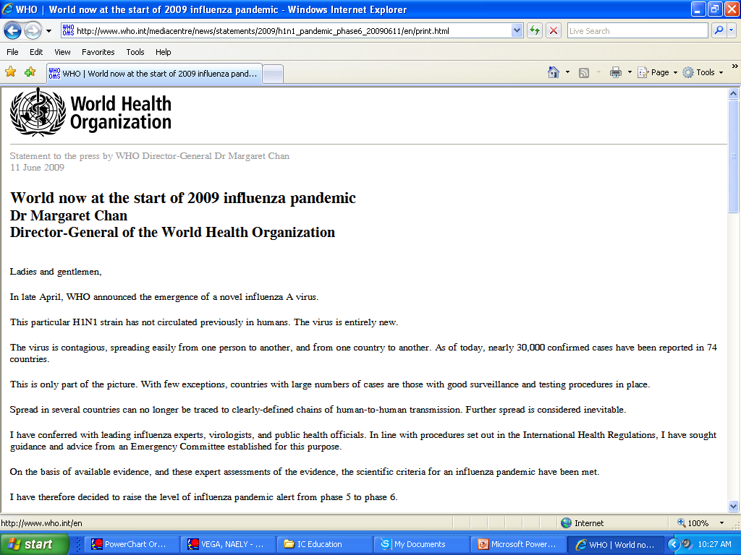
Novel Influenza A H1N1
The World Health Organization (WHO) declared Novel Influenza A H1N1 a pandemic on June 11, 2009 based on increased human to human transmission around the world. This labeling does not indicate severity of the diseases, which, overall has been mild.
Declaring Novel Influenza A H1N1 a pandemic triggers additional efforts towards controlling the spread of the disease.
Stay vigilant for Influenza. Identify and treat patients at high risk for Influenza A H1N1. A nasopahryngeal swab is required for diagnostic testing.
Any employee with Influenza-Like-Illness (ILI)-defined as fever (100ºF or 37.8ºC and a cough and /or sore throat must inform supervisor, wear a mask, and seek medical care immediately.
Employees who have been away from work due to ILI must have medical clearance from Employee Health Service before returning to work.

Slide 32
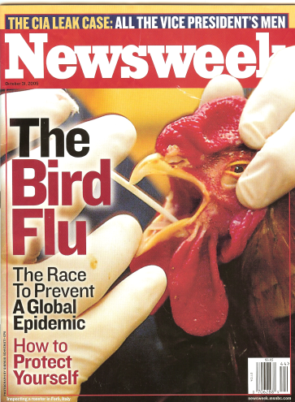
Avian Influenza (H5N1)
Outbreaks have occurred in poultry since 1977 mostly in Asia.
As of August 2006, there have been 241 laboratory confirmed human cases of avian influenza worldwide. Of those cases, 141 have died.
There is concern that the virus will mutate in a way that allows it to spread form person to person.
Early identification of all patients with respiratory symptoms will decrease the risk of transmission of all diseases that transmit through the air by droplets.

Slide 33
Acute Infectious Respiratory Illness Protocol (AIRIP)
Patients presenting with a fever and respiratory illness must be screened at the point of entry to care.
They should be asked the following:
  Do you have a new/worse cough or shortness of breath?
  Are you feeling feverish or do you have a temperature?
If the patient is symptomatic, they must be moved to a negative pressure isolation room when available or a private room with a HEPA filter when not available.
Staff must:
  Wear an N95 respirator, gloves and gown
  Follow Airborne and Contact Isolation Precautions
  John H. Stroger Jr. Hospital Infection Control Policy 07-07-16. Acute Infectious Respiratory Illness Protocol (ARIP) and Fever and Rash Illness Protocol (FRIP)

Slide 34
CDC Category A Bioterrorism Agent Infection Control
Disease | Patient Isolation Precautions | Laboratory Containment
Smallpox | Airborne & Contact | Yes
Plague | Airborne & Droplet | Yes
VHF | Airborne & Contact | Yes
Anthrax | Standard | No
Botulism | Standard | No
Tularemia | Standard | Yes

Slide 35
Control of Transmission of Infectious Rash Illness
Patients presenting with a fever and a rash of unknown origin must be:
  Instructed to wear a surgical mask
  Triaged to a private negative pressure isolation
  room.
Staff must:
  Wear an N95 respirator, gloves and gown
  Follow Airborne and Contact Isolation Precautions
  John H. Stroger Jr. Hospital Infection Control Policy 07-07-16. Acute Infectious Respiratory Illness Protocol (ARIP) and Fever and Rash Illness Protocol (FRIP)

Slide 36
Factors Considered by EHS when
Evaluating if Post Exposure Prophylaxis (PEP) is needed
Source Material
Blood, body fluids, OPIM*, instruments
Type of Exposure
Percutaneous, mucous membrane, or compromised skin
Volume
Small/large, few drops/major splash
Severity
Solid needle vs. large hollow-bore, deep puncture, visible blood on device
HIV status of source
CD4 count, AIDS, viral load
*OPIM (Other Potentially Infectious Material): semen, vaginal, CSF, synovial, pleural, peritoneal, pericardial, amniotic, tissue
~ Report ALL Exposures in a timely manner ~

Slide 37
Comparative Risks of Bloodborne Pathogen Transmission from Percutaneous Injury
(Rule of “3s”)
HIV – 0.3%
Hepatitis C – 3%
Hepatitis B – 30%
Hepatitis B Carries Greatest Risk!

Slide 38
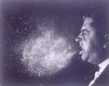
Airborne Pathogens

Slide 39
Airborne Infection Isolation (AII)
Type of isolation | Definition | Patient placement | Employee protection | Examples of organisms
Airborne | Organism transmitted by respiratory droplet nuclei (<0.5 um in size) | 1- Negative pressure isolation room 2- Outside of room place surgical mask on patient | N-95 mask when entering patient room | TB Measles Chickenpox
Notes:
39

Slide 40
Signs and Symptoms of Tuberculosis
Cough
Bloody Sputum
Fever
Chills
Night Sweats
Loss of Appetite
Unintentional Weight Loss
Easy Fatigability
Abnormal Chest X-ray
It is the responsibility of the triage nurse in the ED to screen all patients for the above symptoms. Patients should have a surgical mask placed on them and have an expedited CXR. They shall be placed in the negative pressure isolation room.

Slide 41
Sputum Specimen Collection
Must have at least 3 consecutive sputum specimen collected in 8-24 hours interval.
At least 1 sputum must be an early morning specimen.
Sputum specimen must be collected in an Airborne Infection Isolation (AII) Room or Sputum Induction Booth.

Slide 42
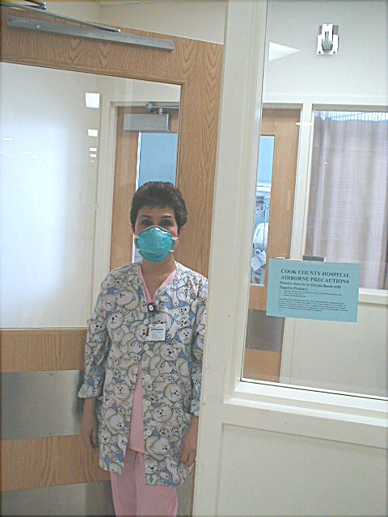
←Monitor
←Sign
Mask→

Slide 43
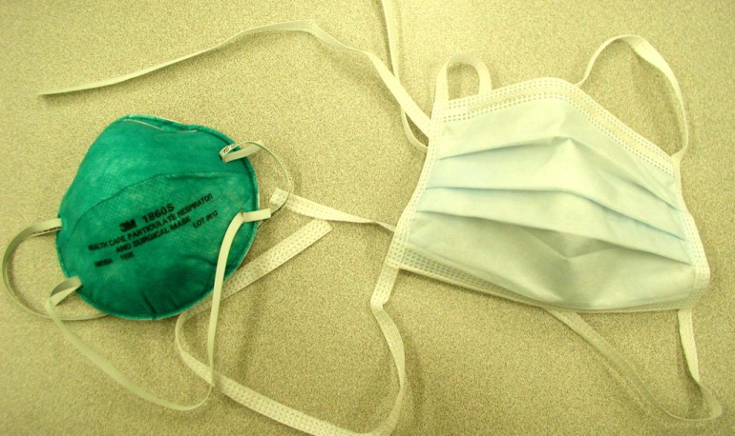
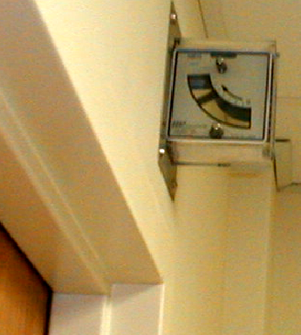
Protect Yourself from Exposure to TB!
HCWs (and visitors) put on an N95 respirator and perform a fit check before entering the room
Check the mechanical monitor to assure the room is under negative pressure
Place a surgical mask on patients when they are out of the Airborne Infection Isolation (AII) Room. Notify receiving department.
N95
Surgical
mask
Mechanical Monitor

Slide 44
Medical Evaluation Following a Positive Tuberculin Skin Test
The medical evaluation is performed by the Employee Health Service and may include the following:
Health Evaluation
Chest X-Ray
Sputum cultures
Medication

Slide 45
Stroger Hospital
2009 PPD Conversion Rate
15 Conversions
4,338 PPDs Placed
Conversion Rate = 0.3%
The risk of occupational
tuberculosis at Stroger
is low.
Most employees at risk for
exposure are tested
every 12 months.
A few groups of employees
at high risk for exposure
are tested every 6 months.

Slide 46
Tuberculosis Cases in Illinois, the City of Chicago and Stroger Hospital 1997 – 2009

Slide 47
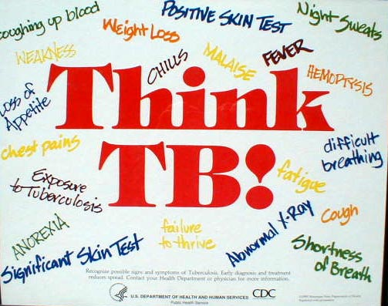

Slide 48
Thank you for your participation and cooperation!
To receive credit for your participation, you must take the quiz at the link below and get a perfect score:
https://forms.office.com/r/B1HxLRXPzL

