Slide 1
INSTRUCTIONS
Welcome, you are about to participate in a hand hygiene educational module.
This module contains information and questions.
You must answer every question correctly in order to continue to the next slide and complete this module and receive your certificate.
You will be directed to the slide containing the information if a question is answered incorrectly . There is no time limit.
You will be asked for your identifying information at the end of the session so that you can receive credit for taking this module.
If you have questions about any of the information contained in this educational module please call Infection Control Department at
(312) 864-4581.

Slide 2

Hand Hygiene Guidelines
John H. Stroger Jr. Hospital of Cook County
03.10.10

Slide 3




Objectives
Upon the completion the HCW will be able to:
 Identify the role of hand hygiene in preventing healthcare associated infections.
 Gain knowledge of different hand hygiene techniques and its indications.
 Identify work activities that can result in hand contamination from environment and patient contact.

Slide 4













Hand Hygiene Guidelines
JCAHO-2010 National Patient Safety Goals Requirement 7A:
–Hospitals are required to comply with current CDC hand hygiene guidelines.
–Set goals for improving hand hygiene compliance.
JCAHO. 2010. Hospital Accreditation Standards.

Slide 5
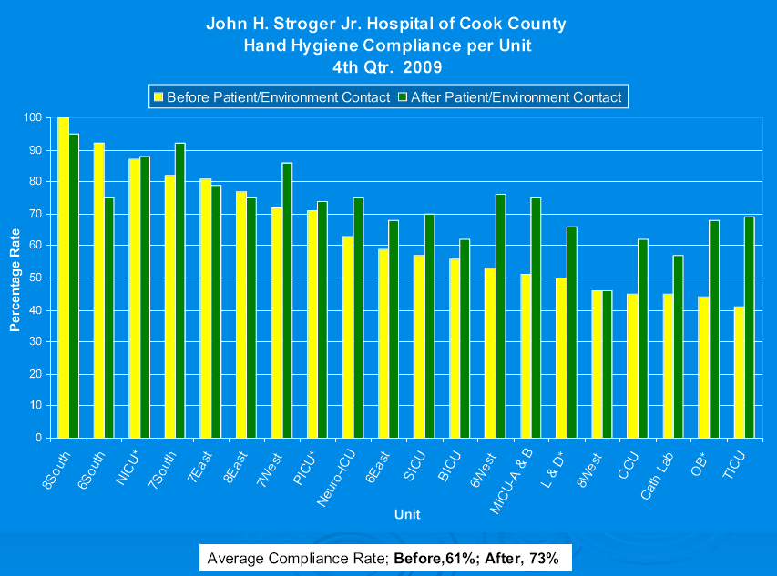
What is OUR compliance?

Slide 6
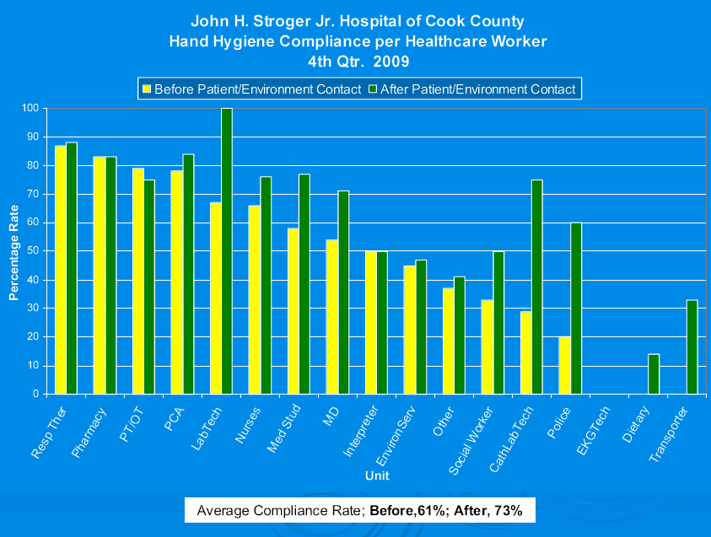
What is OUR compliance?

Slide 7










When to Perform Hand Hygiene based on CDC Guidelines
 Before direct contact with patients
 Before donning sterile gloves when inserting a central intravascular catheter
 Before inserting invasive devices such as indwelling urinary catheters or peripheral vascular catheters
 Before eating or handling food
Boyce, J., Pittet, D., the Healthcare Infection Control Practices Advisory Committee and the HICPAC /SHEA/ APIC/IDSA Hand Hygiene Task Force.Guideline for Hand Hygiene in Health-Care Settings. MMWR, 2002,51, RR-16

Slide 8


















When to Perform Hand Hygiene based on CDC Guidelines
 After contact with intact skin
 After contact with body fluids, excretions, mucous membranes, non-intact skin, wound dressings
 After contact with inanimate objects in immediate vicinity of patient
 After removing gloves
 After using the restroom
 When moving from contaminated-body site to a clean-body site during patient care
 When hands are visibly soiled or when caring for patients with
C-difficile wash with soap & water.
Boyce, J., Pittet, D., the Healthcare Infection Control Practices Advisory Committee and the HICPAC /SHEA/ APIC/IDSA Hand Hygiene Task Force.Guideline for Hand Hygiene in Health-Care Settings. MMWR, 2002,51, RR-16

Slide 9





















How to Perform Hand Hygiene based on CDC Guidelines
Alcohol foam- When hands are not visibly soiled-
 apply alcohol based hand sanitizer to palm of hand
 rub hands together covering all surfaces of both hands until hands are
dry
Hospital approved soap and water- When hands are visibly soiled when caring for patients with C-difficile-
 wet hands with water
 apply soap
 rub hands together vigorously for at least 15 seconds covering all surfaces of hand and fingers
 rinse hands
 dry hands
 use towel to turn off faucet

do not use bar soap
Boyce, J., Pittet, D., the Healthcare Infection Control Practices Advisory Committee and the HICPAC /SHEA/ APIC/IDSA Hand Hygiene Task Force.Guideline for Hand Hygiene in Health-Care Settings. MMWR, 2002,51, RR-16

Slide 10
Why use an alcohol foam for hand disinfection?
 Requires less time to use
3 seconds instead of 30 seconds OR Saves 1 hour for every 8 hours worked!
 Kills bacteria faster
 Less irritating to hands

Slide 11
What are the benefits of hand hygiene?
 Decreases carriage of transient flora on healthcare workers’ hands
 Reduces cross-infection in patients/residents
 Decreases risk of infections caused by organisms acquired
from patients
 Decreases incidence of antimicrobial resistant organisms
 Decreases costs

Slide 12
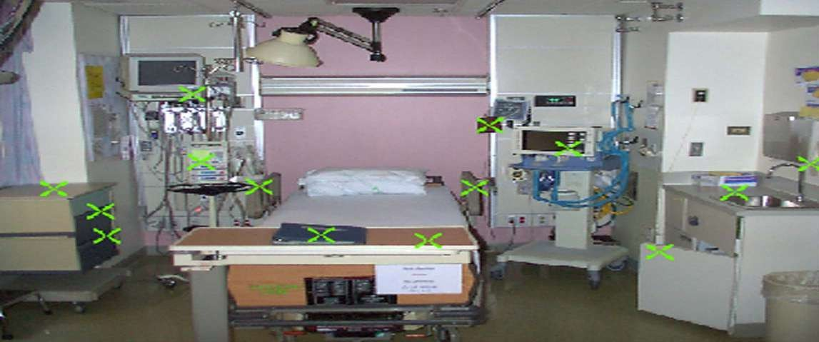



Where can bacteria be found in the health care facility?
🙨 VRE found on these locations
MK Hayden. The Risk of Hand and Glove Contamination by Healthcare Workers after Contact with a VRE (+) Patient or the Patient’s Environment. 41st Annual ICAAC, Chicago 2001.

Slide 13







Colonized or Infected: What is the Difference?
People who carry bacteria without evidence of infection (fever, increased white blood cell count) are colonized
If an infection develops, it is usually from bacteria that colonize patients
Bacteria that colonize patients can be transmitted from one patient to another by the hands of healthcare workers
~ Bacteria can be transmitted even if the patient is not infected ~

Slide 14




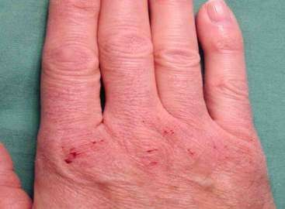

How to maintain healthy hand skin?
 Apply hospital approved lotion
 Do not bring lotion from home ( can be a source of outbreak)

Slide 15



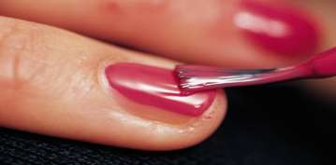










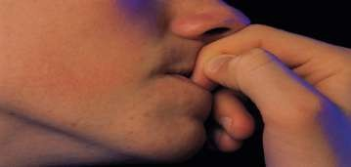

What about fingernails, artificial nails & jewelry?
 After careful hand washing, bacteria can still be found on fingernails.
 Chipped nail polish may support organism growth.
 Artificial nails have been linked to outbreaks.
 Skin underneath rings is heavily colonized.
 Keep natural nails less than
¼ inch long.

Slide 16















What about gloves?
 Wearing gloves does not replace the need for hand hygiene
 Contamination may occur from small undetected holes in gloves
 Contamination can occur during glove removal
 Failure to remove gloves may transmit microorganisms from patient to patient

Slide 17
How can you contribute to improve hand hygiene adherence?
 Be a GREAT role model
 Praise others for cleaning their hands
 Use alcohol foam to kill bacteria on hands or wash hand with antimicrobial soap & water
 Use alcohol foam after removing gloves
 PERFORM HAND HYGIENE BEFORE & AFTER ENTERING ANY PATIENT ROOM, ANY TIME, FOR ANY REASON!

Slide 18
CONGRATULATIONS
You have completed the hand hygiene education module.
To receive credit for your participation, you must take the quiz at the link below and get a perfect score:
https://forms.office.com/r/ry3YJ87Mmm

